Slide 1


Project Presentation KrishiKom Project Id:- PCS 47-73
KIET Group of Institutions, Ghaziabad
(An ISO – 9001: 2008 Certified & ‘A+’ Grade accredited Institution by NAAC)
Guide Name: Mr. Rahul kumar
1.Shivam Sharma (2000290120150) 8C
2.Shivam nautiyal (2000290120149) 8C

Slide 2
Problem Statement
Small-scale and marginalized farmers in the agriculture industry face challenges such as limited access to information, inadequate resources, and a lack of technology-driven solutions. These obstacles hinder their ability to increase income, adopt sustainable practices, and navigate the complexities of modern farming. There is also a need for better communication and collaboration between farmers, government agencies, financial institutions, and startups.
The "KRISHIKOM" project aims to address these challenges by creating a user-friendly mobile application that provides real-time information, expert guidance, and collaboration opportunities for farmers. This innovation seeks to empower farmers, improve their income, and promote sustainable agriculture practices.

Slide 3
Objectives
Weather Monitoring and Crop Advice
Sustainable Agriculture Practices
Community Building and Training
Shared Farming Equipment
Global Market Trend Analysis
Financial Inclusion Partner with Financial Institutions
Farmers - Startups partnership
AR-Based Irrigation Architecture
Loan/EMI Calculator

Slide 4




Technology Used
Server : Node.js
Application : React Native Expo
Database : Firebase
SMS Service :Twilio

Slide 5
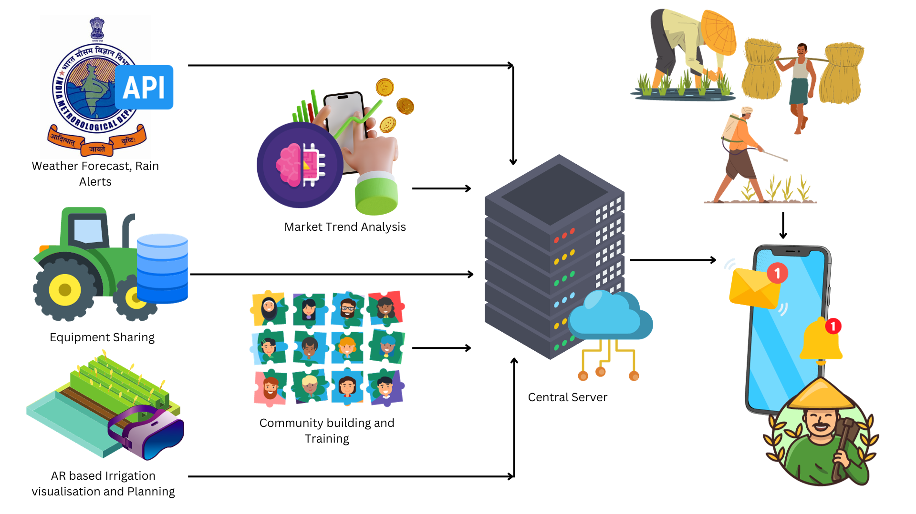
Workflow Diagram
.

Slide 6
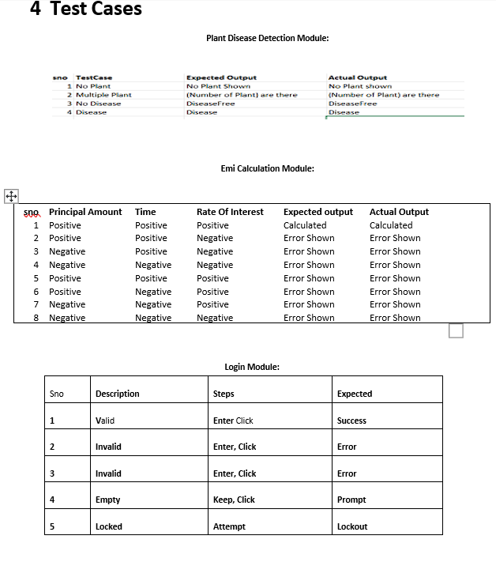
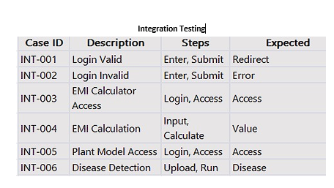

Slide 7
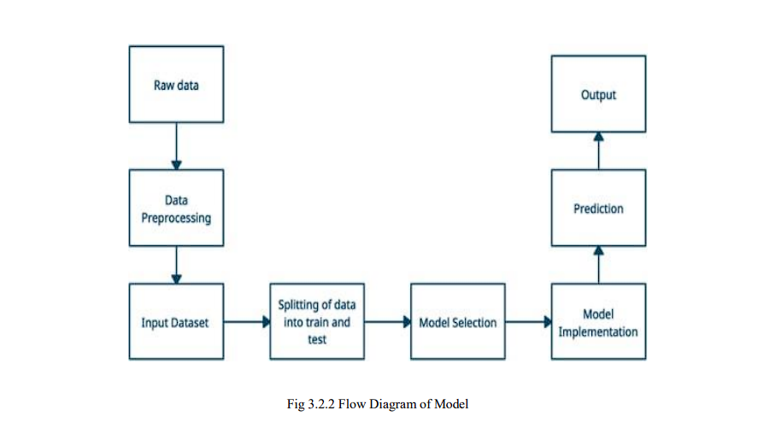

Slide 8
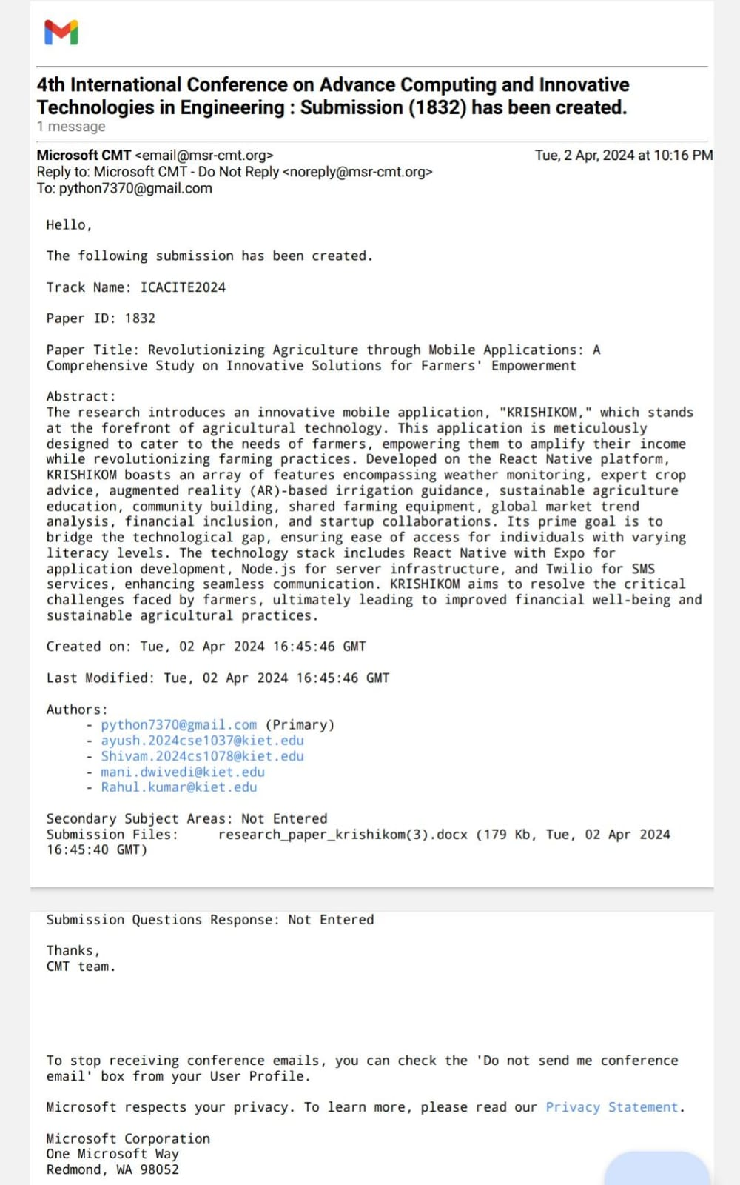
Research Paper Status

Slide 9
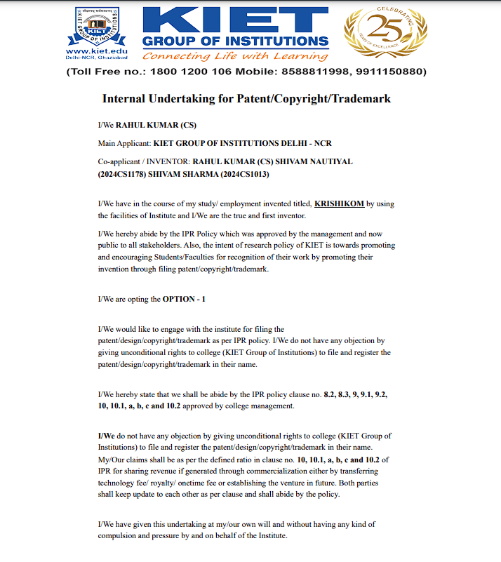
Patent Status

Slide 10


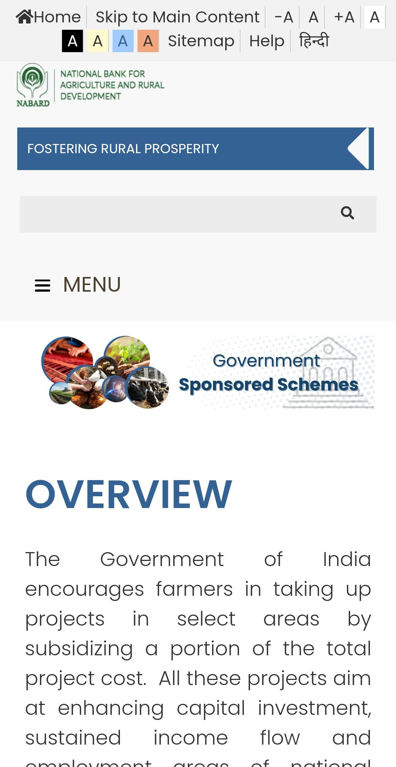

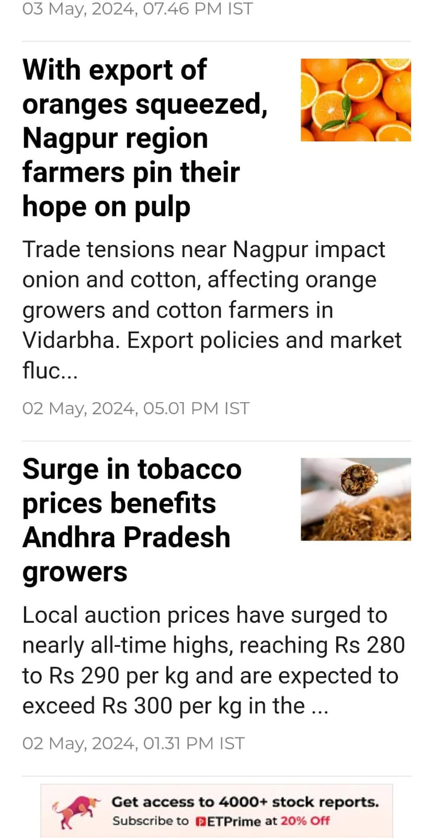
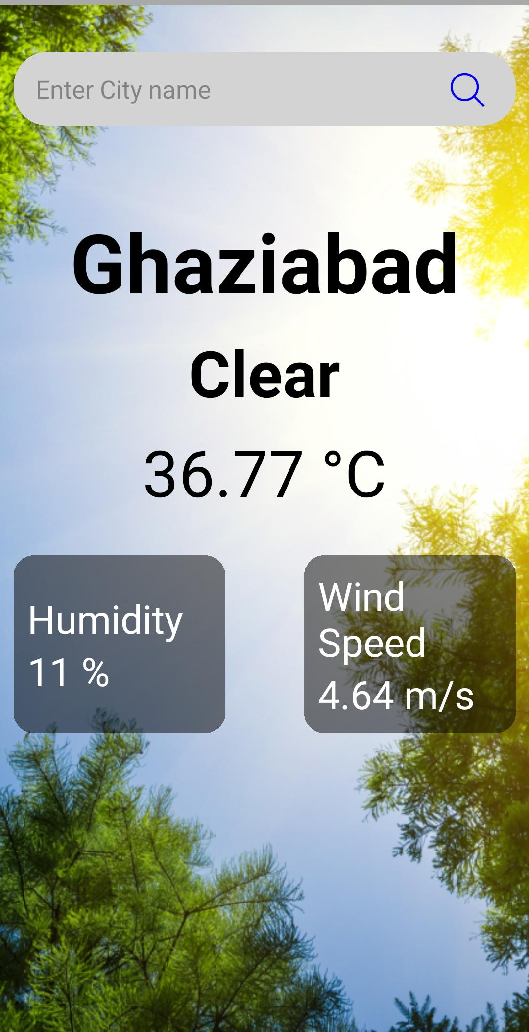
Project Status

Slide 11
sUMMARY/CONCLUSION
The KRISHIKOM application represents a leap forward in assisting the agricultural community by providing an innovative platform aimed at addressing the challenges faced by small-scale farmers. This mobile application incorporates a user-friendly interface, real-time weather monitoring, expert agricultural advice, augmented reality irrigation support, and financial inclusion through strategic partnerships. By recognizing the essential needs of the farming community, KRISHIKOM sets the stage for enhancing the agricultural sector's productivity, sustainability, and financial well-being. The successful deployment of KRISHIKOM is poised to pave the way for a brighter and more prosperous future in agriculture.

Slide 12


